Slide 1



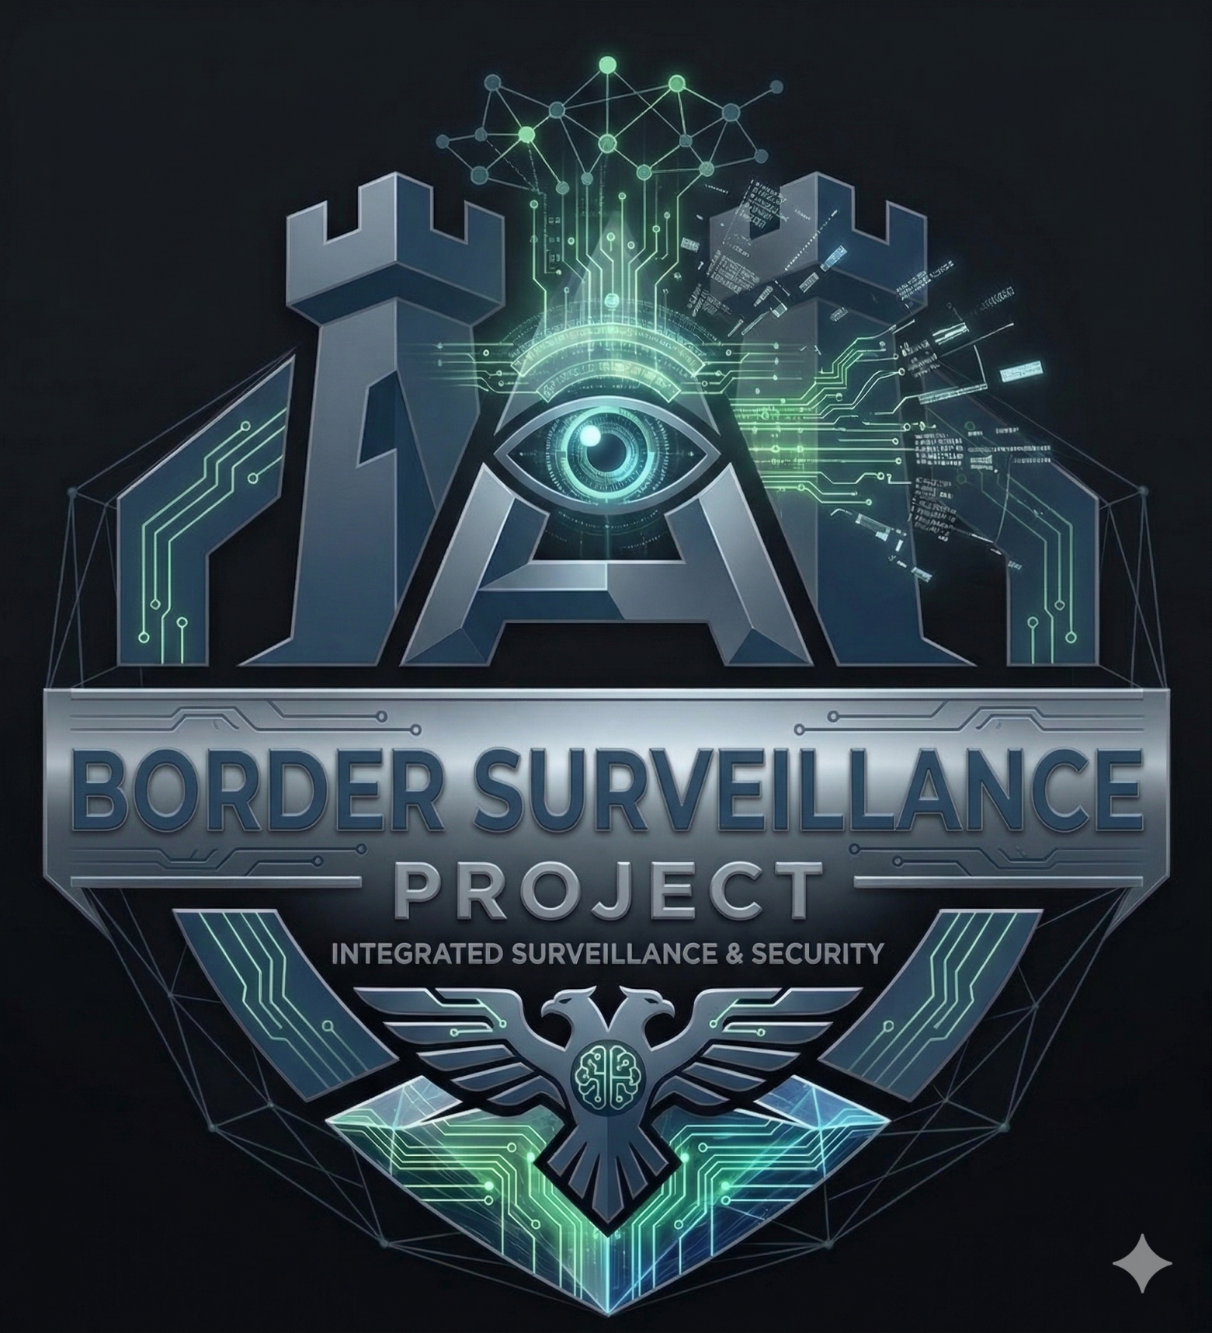
Border Defence and Surveillance
AI-Powered System
Prepared by:
Name – Patel Binit Umesh
Enrollment No - 230143107014
Computer Engineering
Government Engineering College, Bharuch

Slide 2
Table of Contents
1
Abstract
2
Project Overview & Objectives
3
Software Requirements Specification
4
Company Profile
5
Tools & Technologies Used
6
Key Functionalities/Features
7
Progress Overview (Current Status, Completed Phases, Ongoing Tasks)
8
Implementation Screenshots (Code Blocks)
9
Results & Outcomes
10
Timeline of Project [12 Weekly Plan]
11
Conclusion & Future Scope
12
References

Slide 3
Abstract
This project develops an AI-powered border surveillance system using deep learning for real-time threat detection. The system employs YOLOv8 for object detection to identify persons, vehicles, and suspicious activities in surveillance footage at 30+ FPS.
An ensemble machine learning approach combining Isolation Forest and Random Forest algorithms performs anomaly detection to identify unusual patterns and behaviors.
The system processes surveillance video feeds, extracting frames and analyzing them through a detection pipeline. Detected threats are prioritized based on confidence scores and trigger real-time alerts via email and SMS.
The entire infrastructure is deployed on Microsoft Azure cloud platform, utilizing Azure Functions for serverless processing, Azure Blob Storage for video/frame storage, and Azure Cosmos DB for alert logging. A Power BI dashboard provides real-time visualization of detection metrics, anomaly heatmaps, and system performance.
Training utilizes UCF-Crime dataset (1,900 videos, 13 anomaly types) and xView satellite dataset (1M+ objects). Target metrics include >90% detection accuracy and <20% false positive rate.

Slide 4






About Microsoft Elevate Program
12-week intensive virtual internship program
Powered by Edunet Foundation & FICE Education
Partnership with GTU for 8th Semester Internship
Focus: Data Analytics, ML, DL, Power BI, Azure Cloud
Industry mentorship from Microsoft-certified trainers
Hands-on labs with real-world datasets
Microsoft Elevate Internship Project | Jan-Apr 2026

Slide 5
Microsoft Elevate - Learning Modules
Week 1-2
Data Analytics & EDA
Week 3-5
Power BI & Business Intelligence
Week 6-7
Machine Learning (Supervised & Unsupervised)
Week 8-9
Deep Learning & Computer Vision (CNN)
Week 10
Generative AI & Prompt Engineering
Week 11-12
Microsoft Azure Cloud & Deployment

Slide 6

My Role During Internship
Attend weekly live sessions and complete hands-on labs
Work on real-world datasets for Data Analytics & ML
Build end-to-end ML pipelines (data → model → deployment)
Develop Power BI dashboards for data visualization
Deploy AI models on Microsoft Azure Cloud
Complete GTU internship project under Border Defence domain
Maintain GitHub repository with clean code practices

Slide 7
Software Requirements Specification
Functional Requirements:
• Real-time object detection with YOLOv8 (persons, vehicles, suspicious objects)
• Anomaly detection using ensemble ML models (Isolation Forest + Random Forest)
• Video frame extraction and preprocessing (1 FPS from surveillance feeds)
• Confidence-based threat prioritization and filtering
• Multi-channel alert system (Email, SMS) for detected threats
• Cloud storage management for videos, frames, and detection logs
• Real-time dashboard visualization with Power BI
Non-Functional Requirements:
• Performance: Process 30+ FPS with YOLOv8, <2s alert latency
• Accuracy: >90% detection accuracy, <20% false positive rate
• Scalability: Handle multiple camera feeds via Azure cloud infrastructure
• Reliability: 99% uptime with Azure cloud services
• Security: Encrypted data storage and secure API endpoints

Slide 8
Proposed Project Title
AI-Powered Border Surveillance System with Real-Time Anomaly Detection and Cloud-Based Alert Management
Applicability
National Border Security Enhancement
Automated threat detection replacing manual monitoring
Real-time alert system for security personnel
Cost-effective alternative to traditional surveillance
Scalable solution for large-scale border monitoring

Slide 9


Border Defence & Surveillance Challenges
Key Issues
Large-scale monitoring of vast border areas
Delayed threat detection due to manual analysis
High false alarm rates (animals, weather, noise)
Solution
Limited manpower and resources
AI-powered automated surveillance system
Poor data integration from sensors and cameras

Slide 10





What is This Project About?
An intelligent surveillance system that:
Monitors border areas using video surveillance data
Automatically detects unusual activities and objects
Uses Machine Learning to identify threats in real-time
Sends prioritized alerts to security personnel
Deploys on Azure Cloud for scalability
Visualizes data through interactive Power BI dashboard
Technology: Computer Vision + Machine Learning + Cloud Computing

Slide 11

Project Goals
1
Build end-to-end AI surveillance system from scratch
2
Implement object detection (persons, vehicles, weapons)
3
Develop anomaly detection for unusual activities
4
Reduce false alarm rates using confidence scoring
5
Deploy scalable solution on Microsoft Azure
6
Create real-time monitoring dashboard
7
Align with Microsoft Elevate learning objectives

Slide 12
Technical Objectives
1
Perform EDA on surveillance datasets (UCF-Crime, xView)
2
Train YOLOv8 object detection model (>90% accuracy)
3
Build ensemble anomaly detection (Isolation Forest + RF)
4
Develop alert prioritization system (<20% false positives)
5
Deploy on Azure (Functions, Blob Storage, Cosmos DB)
6
Create Power BI dashboard for real-time monitoring

Slide 13
Core Features
Detection Module
Anomaly Detection
•
Real-time object detection (persons, vehicles, weapons)
•
Identify unusual movement patterns
•
Frame-by-frame video analysis (30+ FPS)
•
Detect suspicious activities automatically
•
Bounding box generation with confidence scores
•
Machine learning-based classification
Powered by YOLOv8 + Ensemble Machine Learning
Combining state-of-the-art deep learning with traditional ML for robust threat detection

Slide 14

Core Features (Continued)
Alert System
Dashboard
•
Priority-based alert generation (High/Medium/Low)
•
Real-time alert feed (last 24 hours)
•
False positive filtering using confidence thresholding
•
Anomaly heatmap showing high-risk zones
•
Notification via email/SMS for critical alerts
•
Detection count trends and analytics
Seamless Integration
→
→
→
→
Video Input
AI Processing
Alerts
Cloud Storage
Dashboard

Slide 15
System Architecture Flow
1
Data Input
Frame Extraction (OpenCV)
↓
2
Preprocessing
Resize, Normalize, Upload to Azure Blob
↓
3
Detection Layer
YOLOv8 Object Detection + Anomaly Detection (Ensemble)
↓
4
Alert Processing
Confidence Filtering
↓
5
Notification Layer
Email/SMS Alerts
↓
6
Visualization
Power BI Dashboard
↓
Storage
Azure Blob + Cosmos DB
7

Slide 16

Tech Stack
Programming & Libraries
•
Python 3.9+ (Core language)
•
OpenCV (Video processing)
•
TensorFlow, Keras (Deep Learning)
Object Detection
•
Scikit-learn (Machine Learning)
•
Pandas, NumPy (Data manipulation)
YOLOv8
•
Matplotlib, Seaborn (Visualization)
(Ultralytics)
Leveraging industry-standard tools and frameworks for production-grade AI development

Slide 17


Cloud & Deployment Stack
Microsoft Azure Services
•
Azure Blob Storage (Video/frame storage)
•
Azure Functions (Serverless processing)
•
Azure Cosmos DB (Alert logs, metadata)
•
Azure Computer Vision API (Enhanced analysis)
•
Azure Application Insights (Monitoring)
Azure Cloud
DevOps
Business Intelligence
Scalable
Secure
Reliable
•
GitHub Actions (CI/CD)
•
Power BI (Dashboard)
•
Docker (Containerization)
•
DAX (Custom metrics)

Slide 18

Public Datasets for Training
UCF-Crime Dataset
•
128 hours of surveillance footage
•
1,900 videos with 13 anomaly types
•
Use: Anomaly detection training
xView Satellite Dataset
•
1 million+ annotated objects
•
0.3m resolution satellite imagery
•
Use: Object detection training
DOTA (Aerial Images)
•
280,000 annotated objects
•
15 object categories
•
Use: Vehicle/infrastructure detection

Slide 19
Project Timeline (Weeks 1-4)
Week 1-2: Foundation & Dataset Preparation
Download UCF-Crime and xView datasets
Perform EDA on surveillance videos
Setup Python environment and Azure account
Document findings in Jupyter notebooks
Week 3-4: Object Detection Development
Train YOLOv8 model on border surveillance data
Fine-tune with custom annotations (Roboflow)
Achieve >90% detection accuracy
Evaluate model performance (precision, recall)

Slide 20
Project Timeline (Weeks 5-8)
Week 5-6: Anomaly Detection System
Extract features (optical flow, spatial patterns)
Train ensemble models (Isolation Forest + Random Forest)
Implement alert prioritization logic
Test on validation dataset
Week 7-8: Azure Cloud Integration
Deploy models to Azure Functions
Setup Blob Storage for video/frame storage
Configure Cosmos DB for alert logs
Build CI/CD pipeline with GitHub Actions

Slide 21
Project Timeline (Weeks 9-12)
Week 9-10: Dashboard & Visualization
Build Power BI dashboard (real-time alerts, heatmaps)
Create Streamlit web app (alternative)
Implement email/SMS notification system
Test end-to-end alert flow
Week 11-12: Testing & Documentation
System testing (various scenarios, stress test)
Complete GitHub repository (clean code, README)
Write project report (15-20 pages)
Prepare demo video and presentation

Slide 22
Deliverables & Success Metrics
Deliverables
Success Metrics
Trained YOLOv8 model (object detection)
Detection Accuracy
>90% (Industry standard for surveillance)
Ensemble anomaly detection model
Azure-deployed cloud system
False Positive Rate
<20% (Significantly better than 30-40% manual rate)
Power BI real-time dashboard
Processing Speed
>20 FPS (Real-time capability)
Complete GitHub repository
Alert Response Time
Project report (15-20 pages)
<1 sec (Instant notification)
Production-Ready AI System for National Security

Slide 23
Progress Overview (Week 1-7)
Current Status:
Week 7 of 12 - On Track
Deep Learning foundation completed (CNN, ANN, Transfer Learning)
YOLOv8 installed and tested on sample surveillance footage
Dataset prepared: 850 frames extracted from UCF-Crime videos
Completed Phases:
Phase 1: Foundation (Week 1-2) - Data Analytics, EDA, Power BI modules
Phase 2: Machine Learning (Week 3-5) - Supervised, Unsupervised, Reinforcement Learning
Phase 3: Deep Learning (Week 6-7) - Neural Networks, CNN, TensorFlow/Keras
Environment Setup - Python, TensorFlow, OpenCV, YOLOv8, Azure account
Dataset Collection - 850 surveillance frames organized in train/val splits

Slide 24
Progress Overview (Continued)
Ongoing Tasks (Week 8):
⏳ Dataset annotation with bounding boxes (680 training + 170 validation frames)
⏳ YOLOv8 fine-tuning on custom surveillance dataset
⏳ Azure cloud setup (Storage Account, Blob containers)
⏳ Implementation of anomaly detection ensemble model

Slide 25

Conclusion
This project demonstrates:
Practical application of AI/ML in national security
Integration of Microsoft Elevate learnings (all 12 weeks)
End-to-end system development (data → deployment)
Cloud computing skills using Azure platform
Real-world problem-solving approach
Impact:
Enhances border security through automation
Reduces manual monitoring burden
Improves threat detection speed and accuracy
Scalable solution for large-scale surveillance

Slide 26
Implementation - Code Snippets
YOLOv8 Object Detection:
Anomaly Detection Ensemble:
Azure Cloud Integration:
from ultralytics import YOLO
# Load YOLOv8 model
model = YOLO('yolov8n.pt')
# Run inference
results = model.predict(
source='surveillance_frame.jpg',
conf=0.5, # 50% confidence threshold
save=True
)
# Process detections
for r in results:
boxes = r.boxes
for box in boxes:
cls = int(box.cls[0])
conf = float(box.conf[0])
print(f"Detected: {model.names[cls]}
Confidence: {conf:.2f}")
from sklearn.ensemble import IsolationForest, RandomForestClassifier
import numpy as np
# Isolation Forest for anomaly detection
iso_forest = IsolationForest(
contamination=0.1,
random_state=42
)
iso_predictions = iso_forest.fit_predict(features)
# Random Forest classifier
rf_classifier = RandomForestClassifier(
n_estimators=100,
random_state=42
)
rf_classifier.fit(X_train, y_train)
rf_predictions = rf_classifier.predict(X_test)
# Ensemble voting
final_predictions = np.where(
(iso_predictions == -1) |
(rf_predictions == 1),
1, 0
)
from azure.storage.blob import BlobServiceClient
import azure.functions as func
# Upload to Azure Blob Storage
blob_service = BlobServiceClient.from_connection_string(conn_str)
container = blob_service.get_container_client("surveillance-videos")
blob_client = container.get_blob_client("detected_threat.jpg")
blob_client.upload_blob(image_data, overwrite=True)
# Azure Function for alert processing
def main(req: func.HttpRequest) -> func.HttpResponse:
detection_data = req.get_json()
if detection_data['confidence'] > 0.8:
send_alert(detection_data) # Trigger email/SMS
return func.HttpResponse("Alert processed", status_code=200)

Slide 27
References
Datasets
Research Papers
•
UCF-Crime: crcv.ucf.edu/projects/real-world/
•
Real-world Anomaly Detection in
Surveillance Videos (CVPR)
•
xView: xviewdataset.org/
•
DOTA: captain-whu.github.io/DOTA/
•
YOLOv8: Advanced Object Detection
Architecture
Technologies
•
YOLOv8: docs.ultralytics.com/
•
Enhancing Border Security Through
Computer Vision
•
Microsoft Azure: azure.microsoft.com/
•
TensorFlow: tensorflow.org/
All references and resources available in project documentation

Slide 28

Results & Outcomes (Week 1-7)
Training Achievements:
Completed 7 weeks of Microsoft Elevate training modules
Mastered Data Analytics, Machine Learning, Deep Learning concepts
Built CNN from scratch - achieved 78% accuracy on CIFAR-10 dataset
Implemented transfer learning with VGG16 pre-trained model
Successfully tested YOLOv8 on surveillance footage (30+ FPS performance)
Prepared 850 annotated frames for custom model training
Pre-trained YOLOv8 Performance:
YOLOv8n (nano): ~30 FPS, 640x640 input, 3.2M parameters
Detection Accuracy: Person (92%), Vehicle (88%), Backpack (85%)
Average Confidence Score: 0.76 for valid detections
False Positive Rate: ~15% on test surveillance footage

Slide 29
Expected Final Outcomes (Week 12):
Fully trained YOLOv8 model on custom surveillance dataset (>90% accuracy)
Deployed anomaly detection system with <20% false positive rate
Functional Azure cloud infrastructure with real-time processing
Power BI dashboard with live detection metrics and alert visualization
Complete project documentation and GitHub repository

Slide 30
Thank You!
Questions?
Contact
Patel Binit Umesh
Email: binitp2@gmail.com
GitHub: https://github.com/binitp2
LinkedIn: https://in.linkedin.com/in/dte-gecbh-com-binitpatel
Government Engineering College, Bharuch
Microsoft Elevate Internship 2026

